Slide 1

Understanding Multi-Agent Databases via Independent Learning
This presentation explains how cooperative machine learning improves database performance.
by Anas Khalid

Slide 2
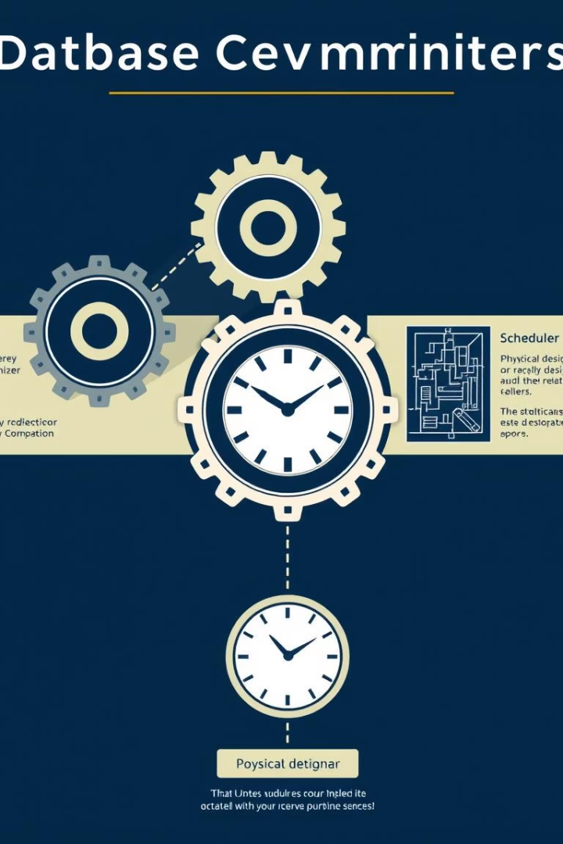
Core Components of Multi-Agent Databases
Query Optimizer
Query Scheduler
Chooses the best way to execute queries efficiently.
Selects which query to run next from the queue.
Physical Designer
Manages how data is physically stored and organized.

Slide 3
MADB: Multi-Agent Database System
Learned Query Scheduler
Learned Query Optimizer
Maximizes buffer hit ratio using reinforcement learning.
Minimizes query execution time by optimizing join ordering.

Slide 4

Why Cooperation Between Components Matters
Conflicting Decisions
Cooperation Needed
Scheduler and optimizer may choose incompatible plans.
Align decisions to improve cache usage and query speed.

Slide 5



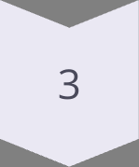
Independent Learning for Cooperation
Separate Training
Each agent learns independently but shares info.
Shared Environment
Agents observe each other's decisions and states.
Common Goal
Reduce overall query latency together.

Slide 6
Information Shared Between Agents
Scheduler Shares
Optimizer Shares
Buffer pool state
Join ordering decisions
Expected data block requests
Recently executed query plans

Slide 7
Performance Results of MADB
7%
12%
24%
Better than Parallel Training
Better than Isolated Training
Better than Traditional Methods
65%
32%
Buffer Hit Ratio
Faster Query Execution
Data accessed from fast memory cache.
Compared to traditional approaches.

Slide 8

Key Takeaway: Cooperation Boosts Database Performance
Smart components alone aren't enough. Cooperation enables better optimization.
Sharing information helps machine learning models find new performance gains.

Slide 9
Thank You
Thank you for your attention and interest in this presentation.

